Slide 1

Frequent Itemsets Mining for Recommender Systems
CMSC5741 – Group 7
WU, Yan | FAN, Bowen | ZHANG, Yaling | LU, Ziwen

Slide 2
01
INTRODUCTION
02
METHODOLOGY
CONTENT
03
RESULT

Slide 3
1
INTRODUCTION

Slide 4
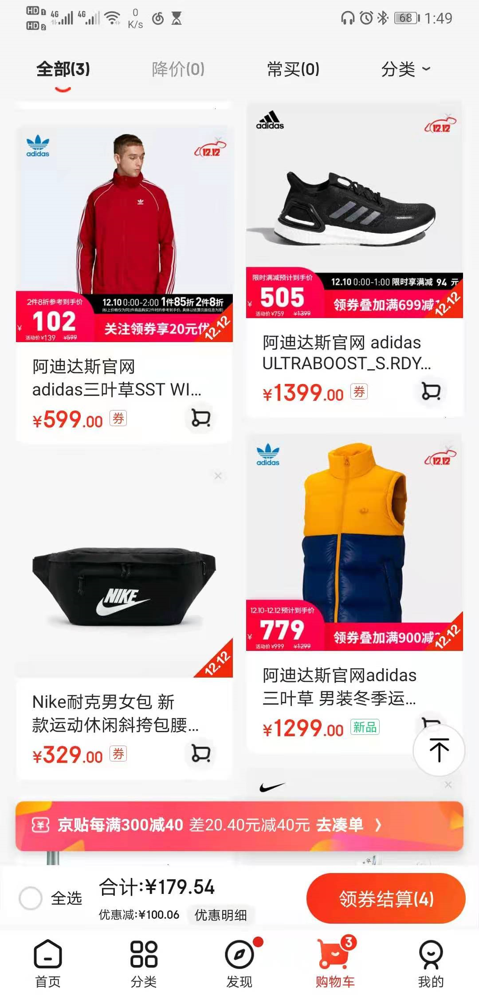
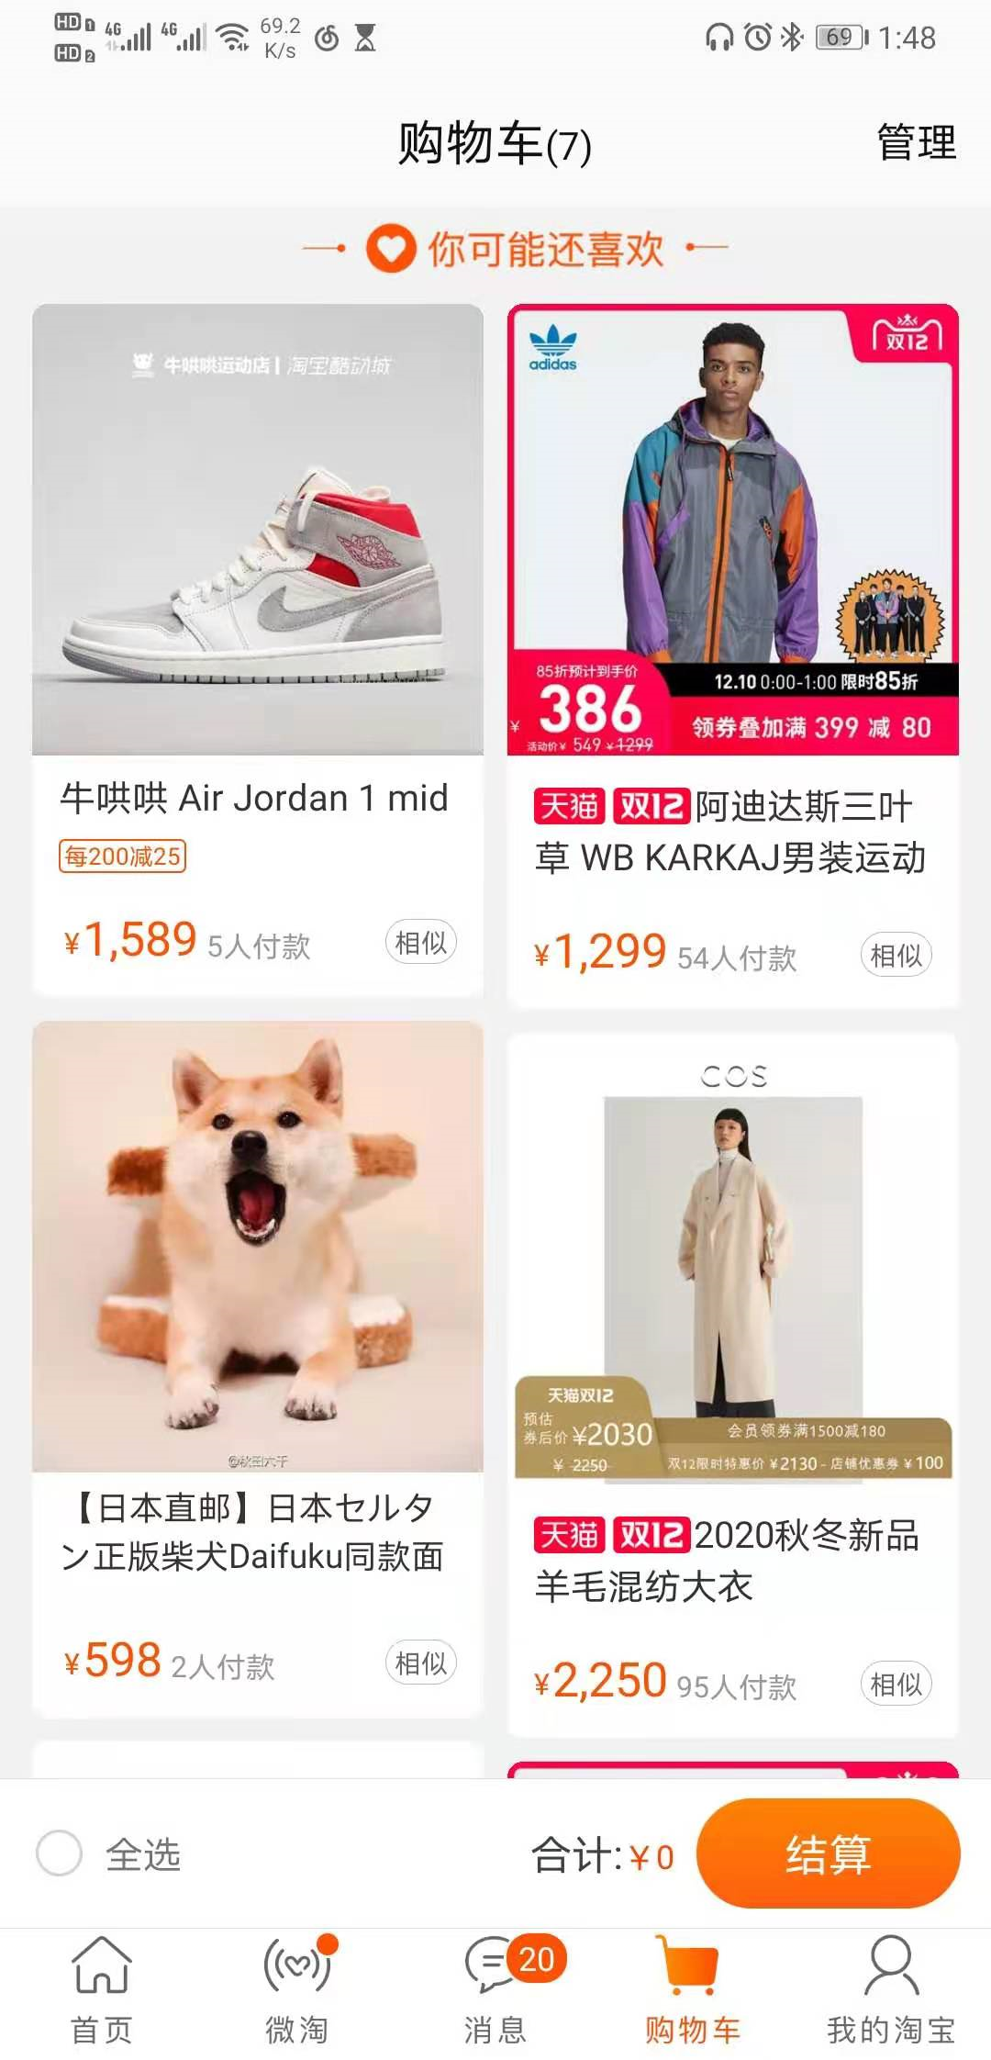
Introduction
Background
Large number of users
1.92 billion people purchased goods or services online
Different consumption habits
Customers’ shopping behavior can be affected by different factors such as regions, personal habits, global events
The rapid growth of e-commerce platforms
Retail platforms have undergone an unprecedented global traffic increase between January 2019 and June 2020
Motivation
Providing customized product recommendation to different customers
Objective
Aims to present more dimensions in regards to item recommendations

Slide 5
2
METHODOLOGY

Slide 6
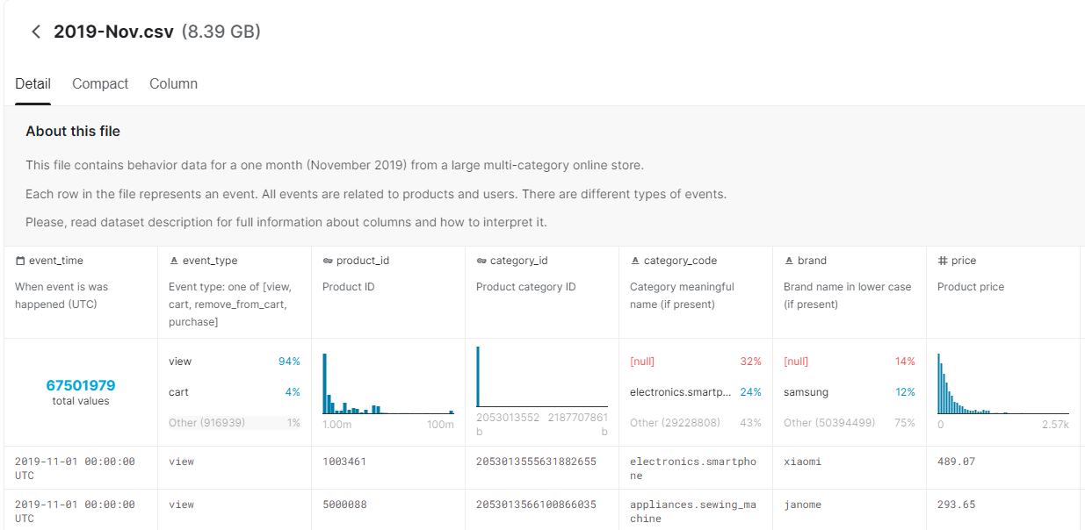
2.1 Data Collection
Data detail
285 million users’ purchasing events
3 months: From Feburary 2020 to April 2020
Dataset | Size | Records
2020-Feb | 7.14GB | 55,318,566
2020-Mar | 7.28GB | 56,341,242
2020-Apr | 8.62GB | 66,589,269
Total Size of Datasets | 23.04GB
Total No. of Records | 178,249,077
2020-Feb.csv
Data source website: https://www.kaggle.com/mkechinov/ecommerce-behavior-data-from-multi-category-store

Slide 7





2.2 Data Pre-processing
step
5
step 4
Data
Cleaning
Data
Saving
step 2
step 3
step 1
Import
Data
Join The
Serial Number
Data
Segmentation

Slide 8
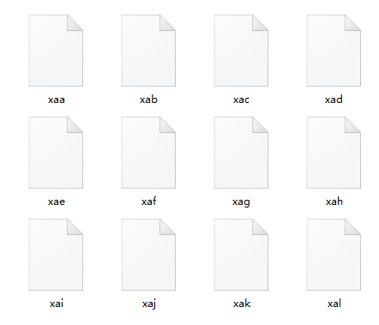
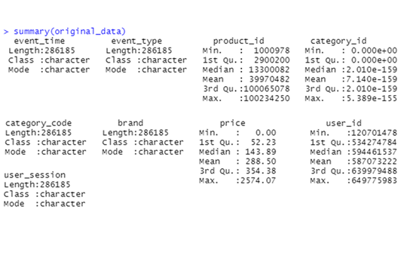
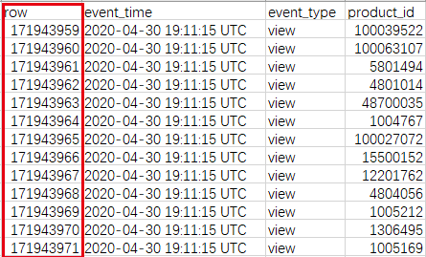
2.2 Data Pre-processing
Data Segmentation
Import Data
Join the serial number
Use Linux's split command to split data:
split -b 800m 2020-Apr.csv
Use fread function to quickly read data
fread(file.choose(),header = TRUE,sep = ",")
Generate a sequence and merge it with the original data.
Find the corresponding data purchase record.

Slide 9
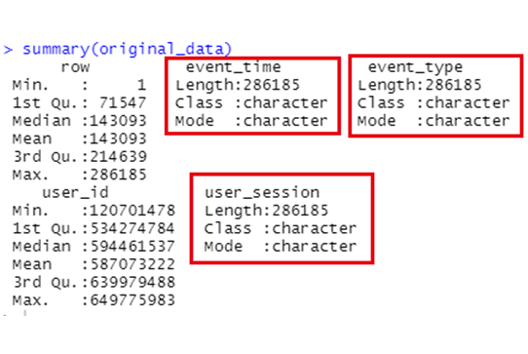
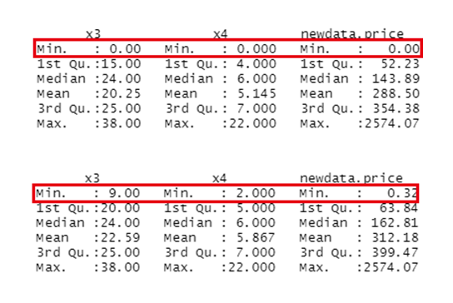
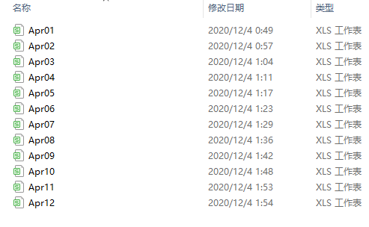
2.2 Data Pre-processing
Data Cleaning
Data Saving
Before
After
1. Convert characters to character length
String type → Numeric type
2. Filter out data
If the character length = 0，there is no string at this position, which is a null value
Save data in CSV format

Slide 10
2.3.1 Frequent Itemset Mining
A-priori Algorithm
SON Algorithm
Purpose:
Find the hidden relationship between items
Two Law:
A-priori’s Law 1: if a set is a frequent itemset, then all its subsets are frequent itemsets
A-priori’s Law 2: if a set is not a frequent itemset, then all its supersets are not frequent itemsets.
In the first scan:
A set of itemsets will be generated, which contains all frequent itemsets
In the second scan:
Each itemset obtained from the last scan will be counted to get its support, and the final frequent itemset will be obtained according to the minimum support

Slide 11


2.3.2 Implementation
Input Data 1
Output Data 1
Mapper C, 1
Mapper A, 1
Reducer A, 1
Mapper B, 1
Reducer C, 1
Mapper C, 2
Input Data 2
Mapper A, 2
Reducer A, 2
Output Data 2
Mapper B, 2
Reducer B, 1
……
Input Data 10
……
……
……
Mapper C, 10
Mapper A, 10
Reducer A, 10
Output Data 10
Mapper B, 10
Data Processing
Input as every Mapper C
Interactive Interface
Decision tree for Recommendation
Database
Query
Database Management
User
Interface

Slide 12
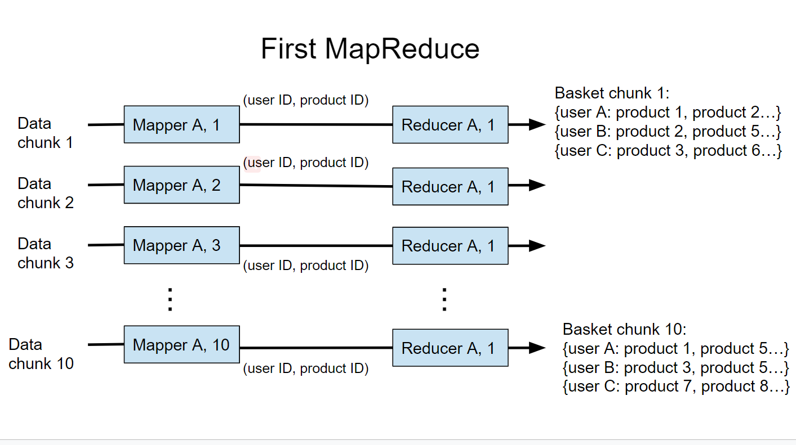
2.3.2 Implementation
Purpose
Produce basket lists
Mapper A
Read in the retail store data
Sort the data according to the user ID.
Output a tuple :[user ID, product ID]
Reducer A
Collect all the product IDs and assign them

Slide 13
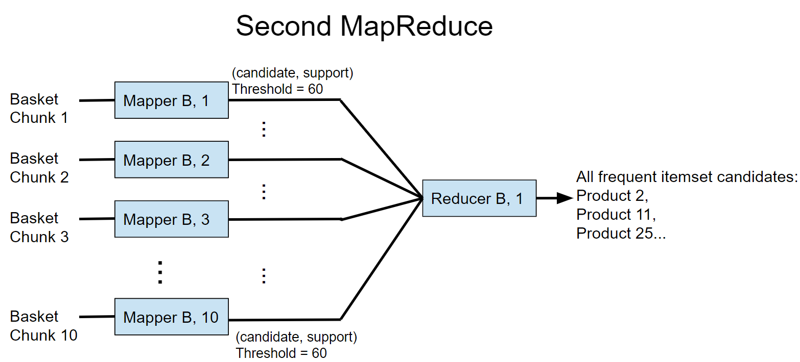
2.3.2 Implementation
Purpose
Find all the frequent itemset candidates
(A-priori algorithm )
Mapper B
Handle the baskets of the 10 chunks
Reducer B
Checked repetitiveness of the incoming frequent itemset candidates
Removed repeated frequent itemsets

Slide 14
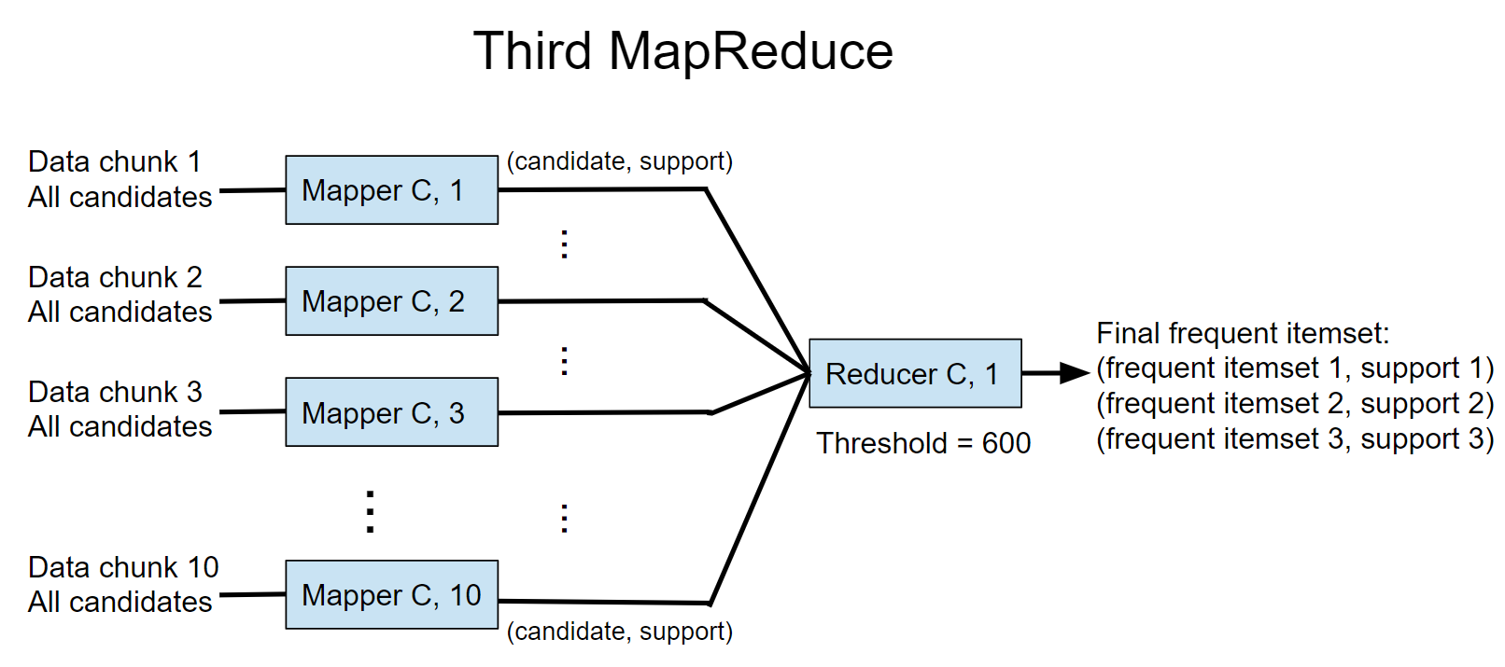
2.3.2 Implementation
Purpose
Finding the true frequent itemsets
Returning all true frequent itemsets with their support.
Mapper C
Calculate the support for the list candidates
Reducer C
Sum all supports of the same candidate
Filter out terms with support no less than 600
Return the true frequent

Slide 15
2.4.1 Recommend Algorithm
Table 1 : Example of Purchasing History Datasets
User ID | Baskets
001 | A,B,C,D
002 | A,D
003 | A,C
004 | B,D
005 | C
A different approach
Based on the frequent item sets for generating a decision tree
Frequent Item sets generation
A-Priori algorithm and Hadoop platform
Generate frequent item sets with size from 1 to 4
Table 1: few parts of user-basket pairs which is extracted from original data
MapReduce implementation
Fixed support threshold
Make use of multiple rounds of MapReduce jobs to find frequent item sets with size from 1 to 4.
Table 2 : shows a sample of itemsets and their support threshold
Table 2 : Itemsets and their support threshold
Itemset | User Id | Support threshold
{} | 001，002，003，004，005 | 5
A | 001，002，003 | 3
B | 001，004 | 2
C | 001，003，005 | 3
D | 001，002，004 | 3
A,B | 001 | 1

Slide 16
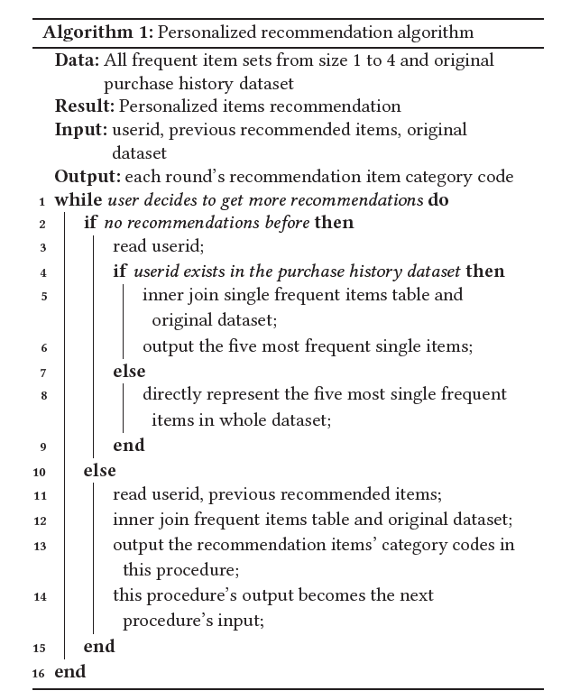
2.4.2 Recommend Algorithm
Example of recommendation procedure
Pre Itemset | Current Recommended Itemset | Future Recommend-ed Itemset
{} | {A} | {C,D}
 | {B} | Null
 | {C} | {A}
 | {D} | {A}

Slide 17
3
RESULT

Slide 18
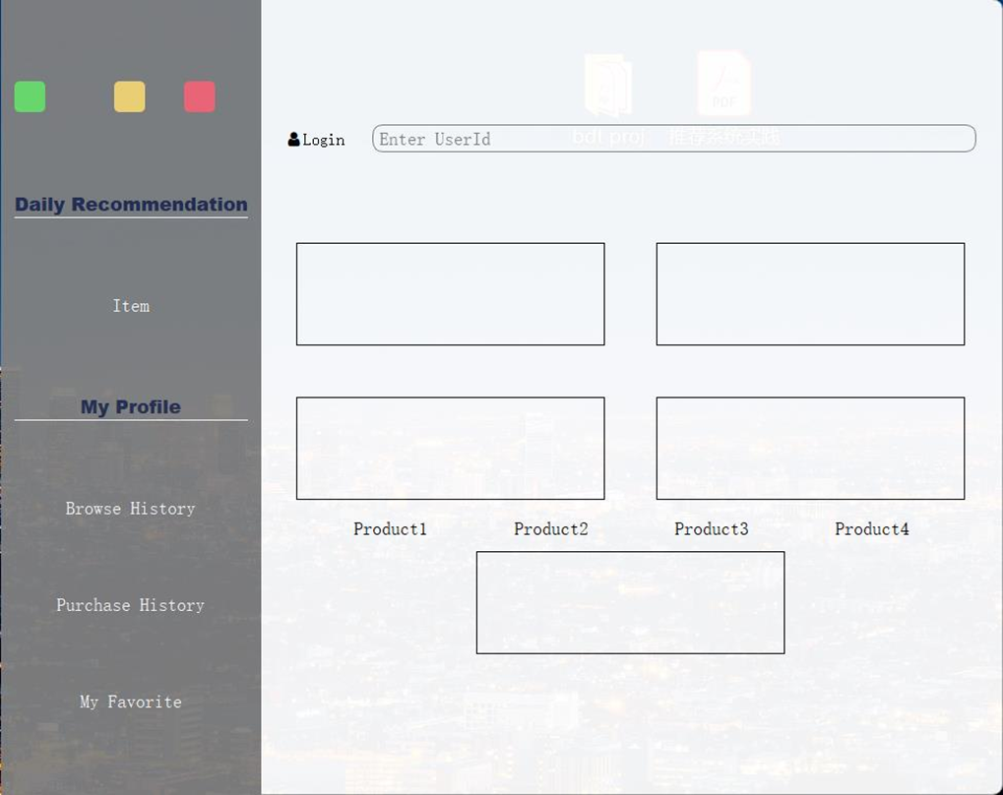
Result
Step 1:
Input his/her user_id to login and click the item button in the left form to ask for recommendation.
Step 2:
Recommender system will first recommend what he/she has bought according to the browse history.
Step 3:
User will click the button in the bottom part of the right form to ask for more recommendation if he/she is not satisfied with the first round recommendation.
Step 4:
Recommender system will search from the frequent item pair to do next round recommendation until the quaternion pair is recommended.

Slide 19
Thanks for Listening

